Slide 1
Stress Based Topology Optimization of Bridge
ES-622
Project Milestone -04
Presented By Guided By
Gaurav Singh Dr Sushobhan Sen
Saurabh Kumar Sharma
Avinash Kumar Jha

Slide 2
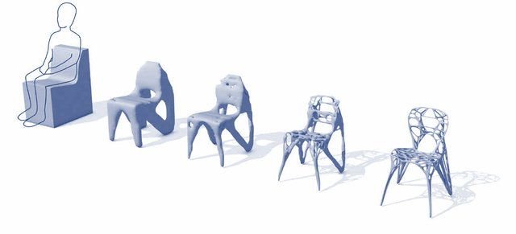
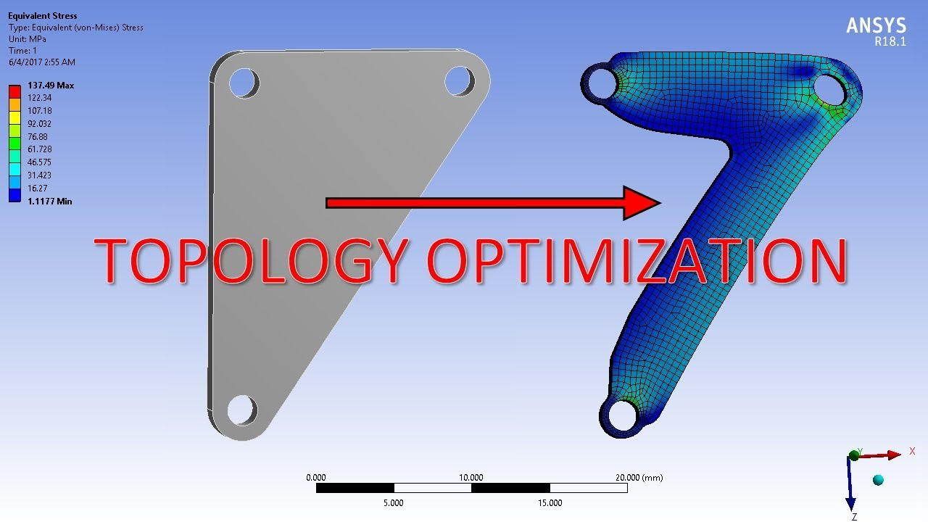
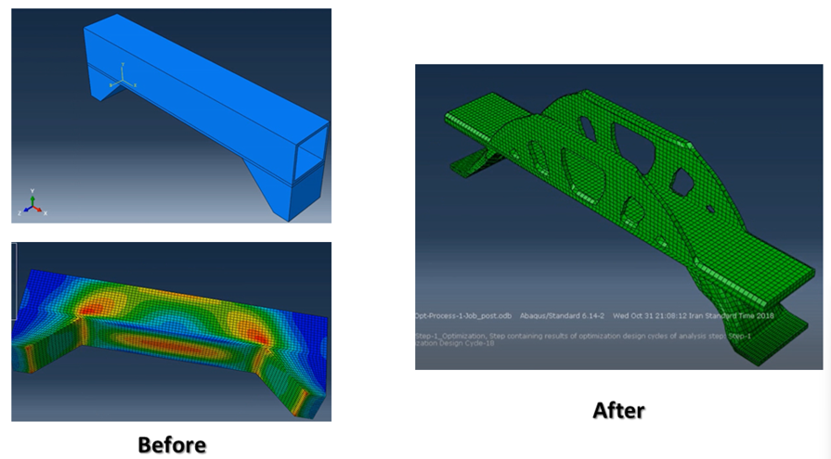
Motivating Examples
Source in reference

Slide 3
Introduction and Motivation
Bridges are critical infrastructure components that must withstand a wide range of loading conditions, including wind, earthquakes, and vehicular traffic.
The motivation for using topology optimization in bridge design is to improve the structural efficiency of the bridge, which is typically achieved by reducing the weight of the structure while ensuring that it meets the required performance specifications.
A lighter bridge can offer several advantages, such as lower material usage, reduced construction costs, and improved durability.

Slide 4
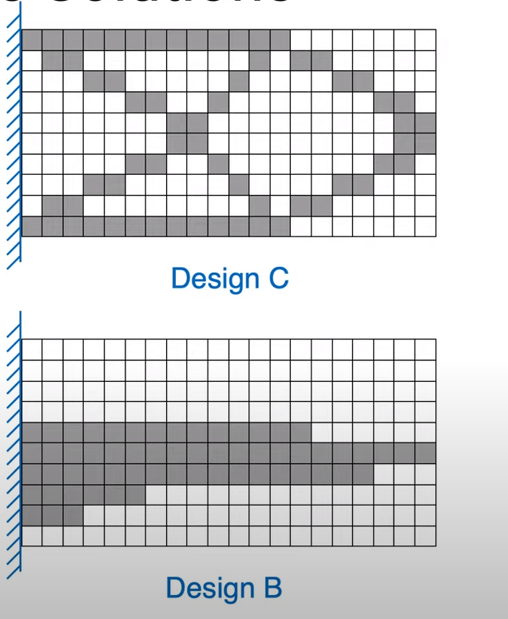
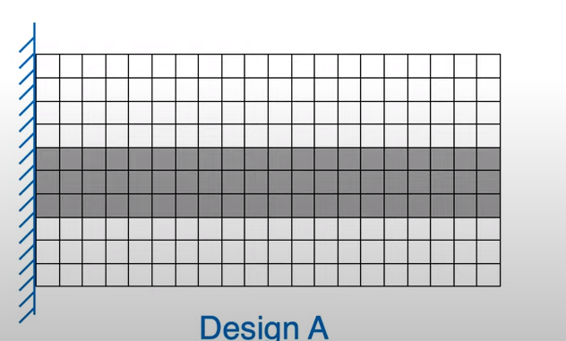
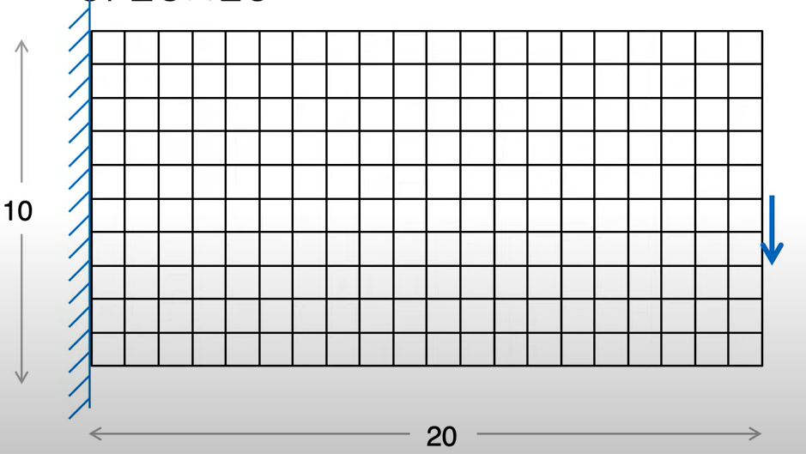

Background of problem, 20x10 size block
number of possible solutions:
$C_{60}^{200}$ = $\frac{200!}{60!∗\left(200−60\right)!}=7.04∗10^51$
Source in reference

Slide 5
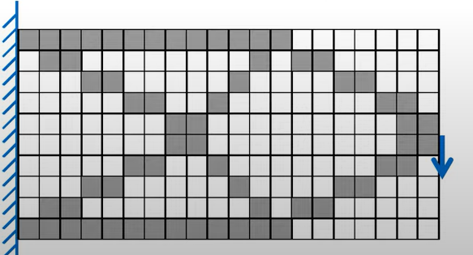
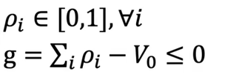
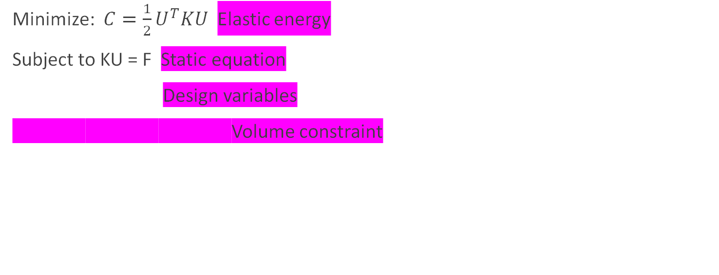
Governing optimization equation
Minimize: $C=\frac{1}{2}U^{T}KU$Elastic energy
Subject to KU = F Static equation
Design variables
Volume constraint

Slide 6
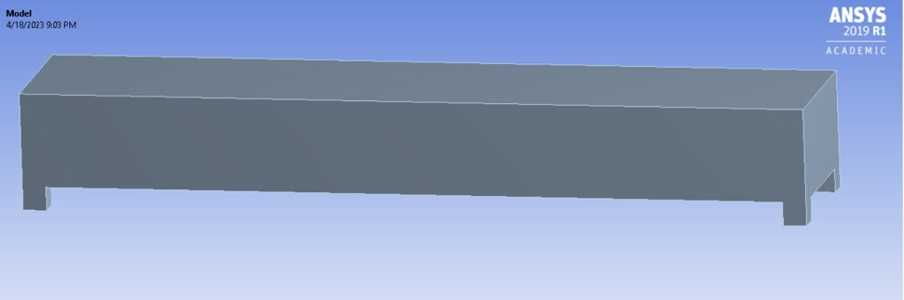
Geometry
concrete bridge
Length of the Member = 60m
Width of the Member = 10m
Breadth of the Member = 5m
Area of the Member = 300m³

Slide 7
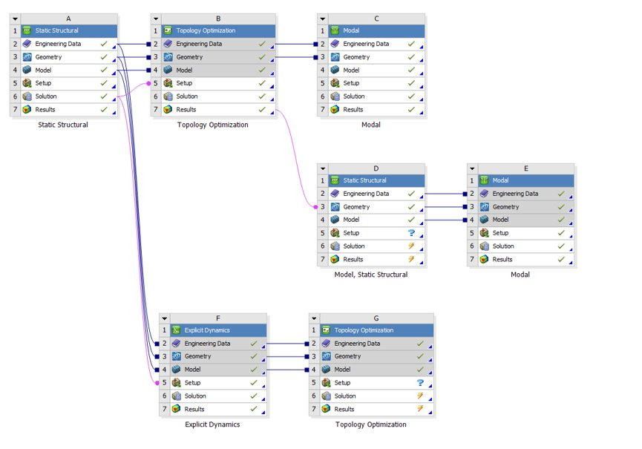
Ansys Workflow

Slide 8
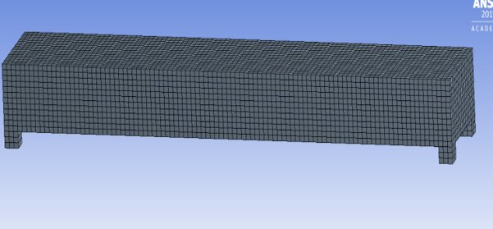
Brick dominant meshes are more accurate as compared to other 3d meshes as they have more number of nodes, assumed that you need 5 tests for every brick element in the model to get the same results.
Brick Dominant mesh Sizes of 1m,0.5m and 0.25m

Slide 9
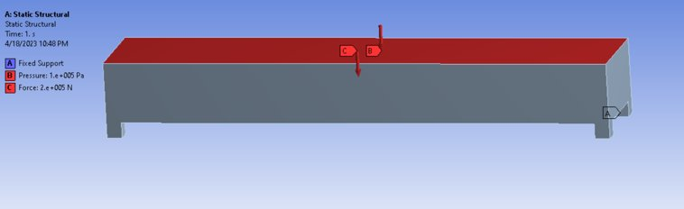
Loading and Boundary Conditions
Four abutments have fixed support.
For the selfweight of the concrete, a pressure of 100Mpa was considered, and for the live load moment of automobiles, we evaluated a 200kN moving load at various points but put it at the Center for simplification.

Slide 10
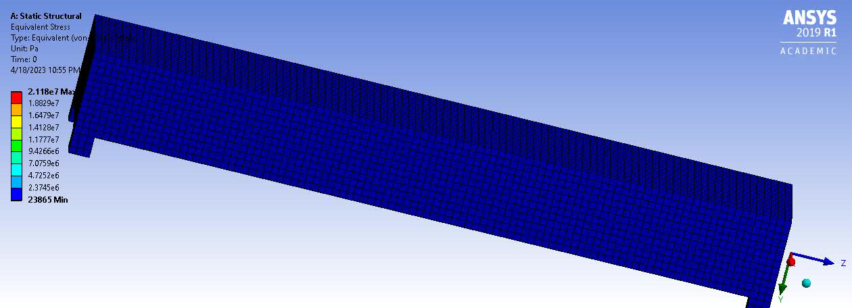
Propagation of stress

Slide 11
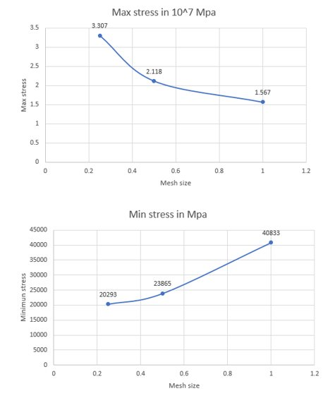
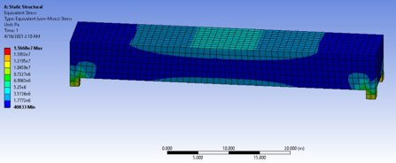
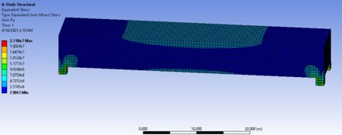
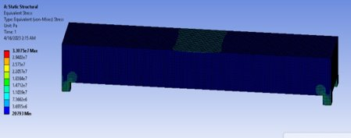
Stress convergence
As we see the stress propagates in an arch manner we can therefore conclude our optimized geometry also must look like an arch form

Slide 12
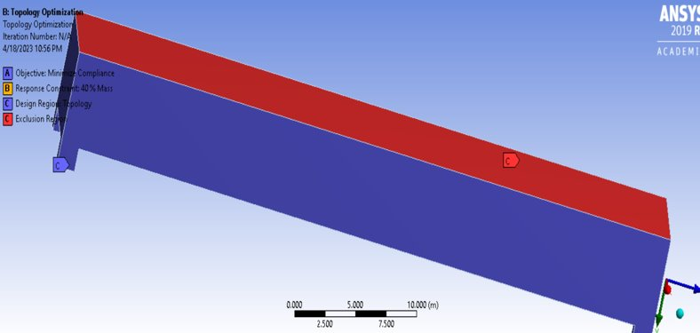
Goal of Topology Optimization
0.1% convergence accuracy
The final solution obtained should be accurate up to a tolerance of 0.1%.
40% mass reduction
The optimized design should be at least 40% lighter than the initial design, while still meeting the required specifications.
*The optimization process should only consider the main structural components and not the deck or supports.

Slide 13
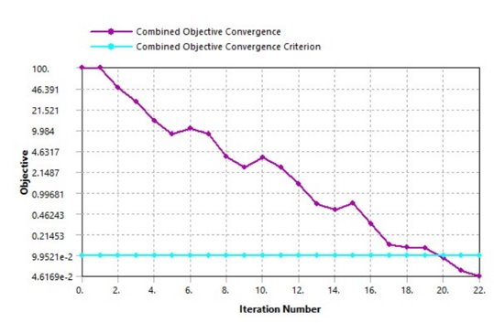
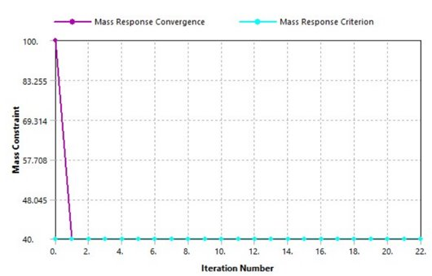
Iterative convergence of Mass and Stiffness.
The iterative process is necessary because the initial estimates of the mass and stiffness matrices are typically rough approximations, and refining these estimates is crucial for accurately predicting the behaviour of the structure under different loads and conditions.

Slide 14
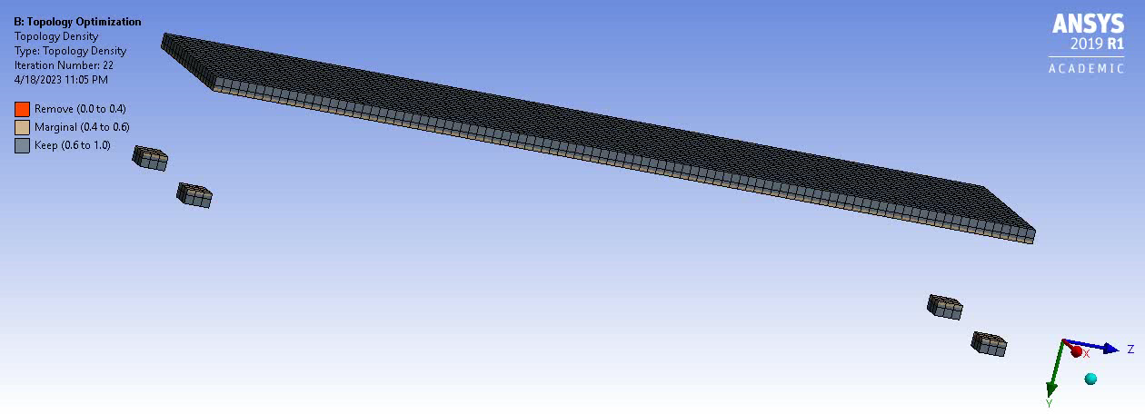
With each repetition, provide the following response:
*The response refers to the deformation, stresses, strains, and other quantities that characterize the behaviour of the structure under the applied loads and conditions.

Slide 15
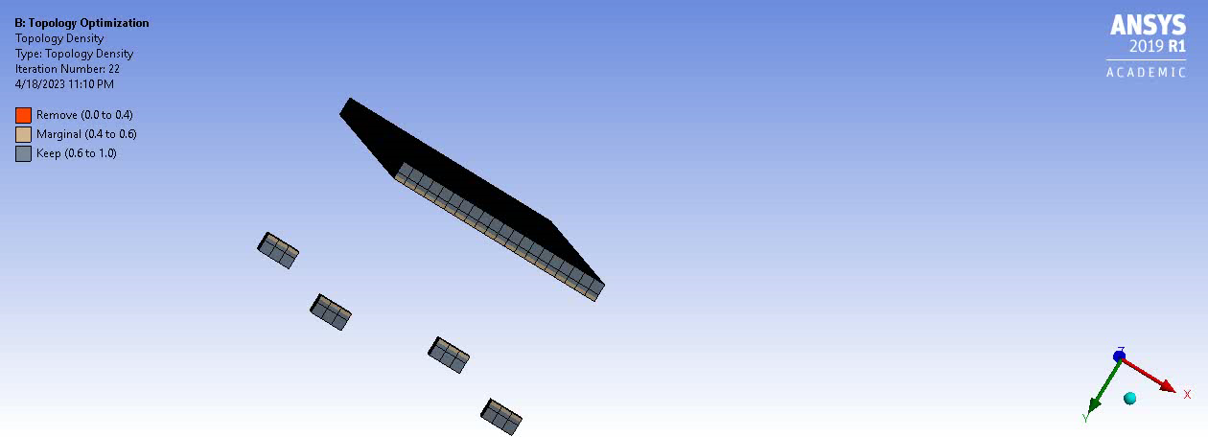
Mass Removal (view from a cross section)

Slide 16
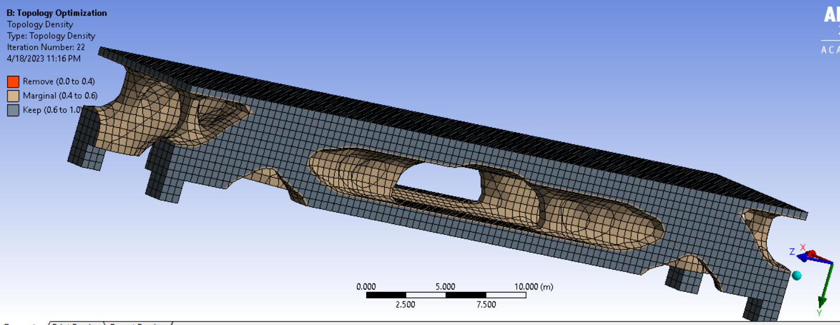
The final shape post optimization:

Slide 17
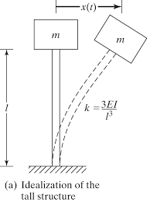
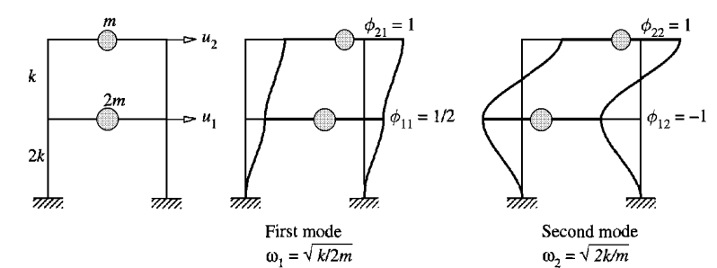
Modal analysis: mode shapes and frequencies

Slide 18
Modal analysis
Governing equation:
Mu¨+Cu˙+Ku=f(t)
•As natural frequencies and associated mode shapes are structures property and independent of loads.
•Also, for modal analysis we generally do not include damping.
Final equation:
Mu¨+Ku=0
Free and undamped system will give us mode shapes and modal natural frequencies of structure

Slide 19
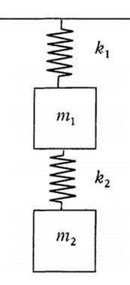
Spring mass system oscillating with u(t)=Φ_{n}(Acos(w_{n}t)+Bsin(w_{n}t))
(K-w^2 _{n}M) Φ_{n} =0
Which is an eigen value problem.
• On solving we get natural frequencies and its corresponding mode
Shapes.
Mode shapes represent relative displacement.

Slide 20
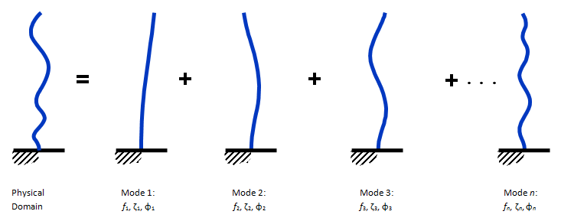
MDOF system

Slide 21
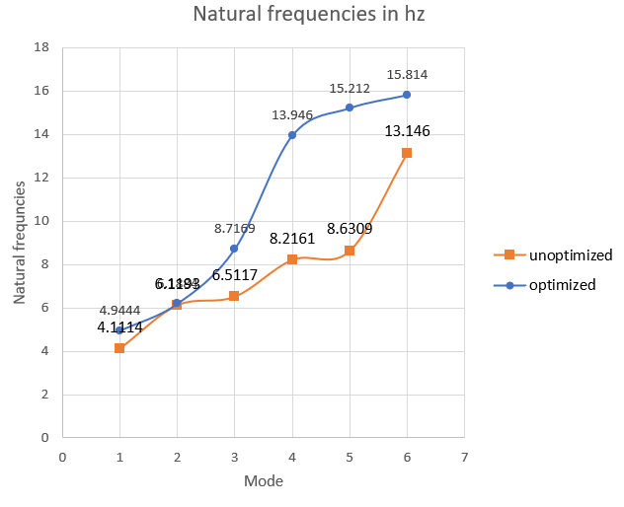
Modal analysis results Natural frequencies
Frequency of unoptimized structure
Frequency of optimized structure
Mode | Frequency [Hz]
1. | 4.9444
2. | 6.1884
3. | 8.7169
4. | 13.946
5. | 15.212
6. | 15.814
Mode | Frequency [Hz]
1. | 4.1114
2. | 6.1193
3. | 6.5117
4. | 8.2161
5. | 8.6309
6. | 13.146

Slide 22
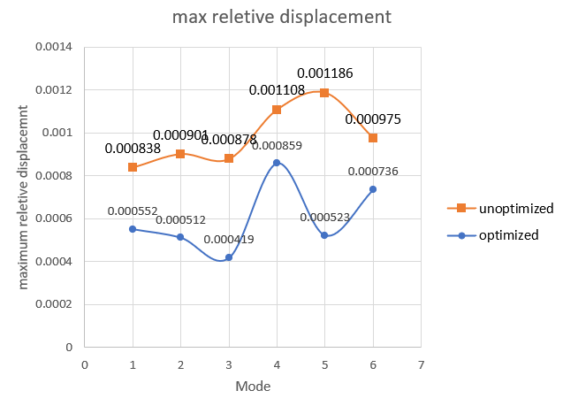
Results of the modal analysis Max relative displacement for the mode form
Mode | Max displacement unoptimized | Max displacement optimized
1 | 0.000552 | 0.000838
2 | 0.000512 | 0.000901
3 | 0.000419 | 0.000878
4 | 0.000859 | 0.001108
5 | 0.000523 | 0.001186
6 | 0.000736 | 0.000975

Slide 23
Conclusion
After conducting topology optimization for the bridge, an optimized arch shape was obtained, which was confirmed by examining the stress propagation contour that also followed an arch shape. This new shape, combined with a modified cross-section, resulted in increased stiffness and reduced weight of the bridge.
Further mass reduction was possible until failure occurred, which was defined by a maximum displacement at the mid-span of 1/800th of the bridge span. The plots generated during modal analysis showed that increasing stiffness resulted in lower maximum relative displacements.
Changes in mass and stiffness also led to modifications in the natural frequencies of the bridge. Overall, topology optimization proved to be an incredible tool for creating aesthetically pleasing designs with more uniform stress distribution, reduced displacements, and decreased mass.

Slide 24
Further study
We can attempt to use our findings in dynamic loading scenarios in the future to observe how these shape values change.
References
Transportation Research Board. Bridge aesthetics around the world. Washington, DC: Transportation Research Board, National Research Council, 1991.
Chen YJ. Topology optimization of bridge-type structures with multiple constraints. MPhil Thesis. School of Engineering, Griffith University Gold Coast Campus, Gold Coast, Australia, 2000.
https://www.worldscientific.com/doi/10.1142/S1465876301000295
https://link.springer.com/article/10.1007/S00158-015-1274-4 4.
https://www.sciencedirect.com/science/article/pii/S0045794902004406 5. Chen YJ. Topology optimization of bridge-type structures with multiple constrains MPhil Thesis. School of Engineering, Griffith University Gold Coast Campus, Gold Coast, Australia, 2000.
Solid works website
Images credits Jun woo introduction to topology optimization

Slide 25


